Slide 1

Initial Problems of Pakistan
Understanding the Challenges of a New Nation (1947–1950)
Presented by: 25F- CY-098 MUNAF AHMED KHAN 25F-CY-074 MUHAMMAD SHAHMEER 25F-CY-066 MUDASSIR

Slide 2

The Birth of a Nation
August 14, 1947: A Monumental Achievement Met With Unprecedented Challenges

Slide 3






Overview of Initial Crises
Humanitarian
Asset Division
Geographic
The influx of millions of traumatized refugees created an immediate and overwhelming disaster for a state with no infrastructure.
India deliberately withheld critical financial and military assets, aiming to cripple Pakistan's foundation before it could settle.
Separated by 1,600 km of hostile land, the nation faced the unjust Radcliffe Award, sparking the immediate Kashmir dispute.

Slide 4
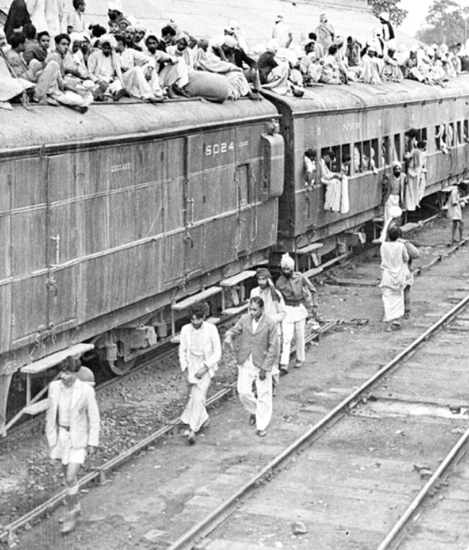
The Refugee Crisis
Mass Migration
The partition triggered one of the largest and most tragic mass migrations in human history. Millions of Muslims left their ancestral homes, facing extreme violence and hardship.
The nascent government was entirely overwhelmed. There was a desperate lack of food, shelter, and medical facilities to accommodate the population arriving by trains and foot convoys.
Despite the lack of resources, the local population made immense sacrifices to shelter their incoming brethren.

Slide 5

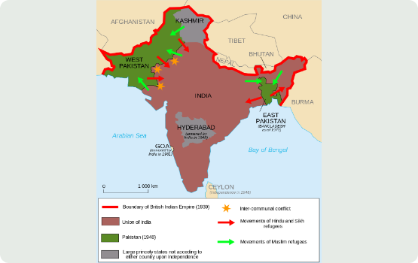
Geographical Divide
Pakistan was a geographically unusual nation at birth, comprising two halves—West Pakistan and East Pakistan—separated by over 1,600 kilometers of hostile Indian territory.
This unnatural physical separation bred significant administrative nightmares. Defending both wings required enormous military and logistical resources. Furthermore, trade between the two wings was nearly impossible without lengthy detours around India.
This geographical isolation inevitably bred economic neglect and deep resentment in East Pakistan, accelerating the path toward the 1971 war.

Slide 6
Unjust Division of Assets
200M
Financial Strangulation
At partition, it was agreed that Pakistan would receive Rs. 750 million as its rightful share of the cash balances from undivided India.
Rupees Initially Paid
However, India initially paid only Rs. 200 million and deliberately withheld the remaining funds. This malicious delay was designed to cripple the nascent state financially and prevent it from running the daily affairs of the government.

Slide 7
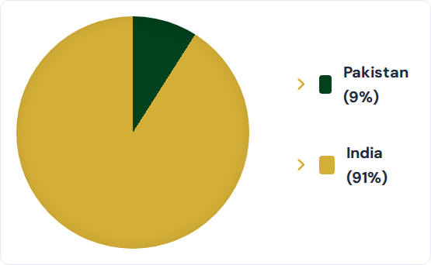
The Industrial Void
An Agrarian Economy
Pakistan inherited an overwhelmingly agrarian economy with virtually no industrial backbone. Out of 394 major industrial units existing in undivided India, the new nation received a mere 34.
This stark disparity meant a critical shortage of manufactured goods, raw materials, capital, and technical expertise, forcing heavy reliance on imports to survive.

Slide 8
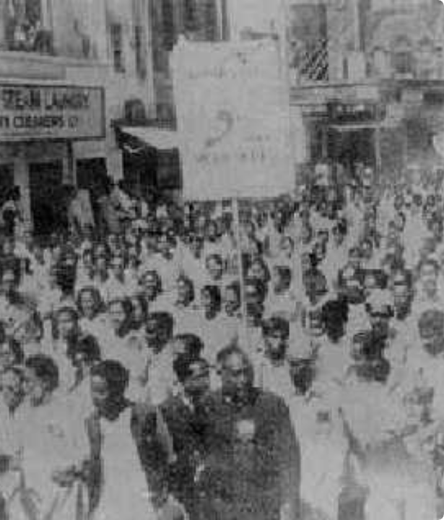
Language Controversy
East Pakistan (now Bangladesh) constituted over 54% of the population, predominantly speaking Bengali. When the central government declared Urdu as the sole national language, Bengalis felt their cultural identity was being erased.
On February 21, 1952, student protests erupted in Dhaka. Police opened fire, resulting in tragic fatalities. This day is now globally recognized as International Mother Language Day.
This controversy caused irreparable damage, deeply alienating East Pakistan and serving as a fundamental root cause for the eventual separation of Bangladesh in 1971.

Slide 9


Administrative Nightmares
Building from Scratch
Early Political Instability
Karachi was chosen as the capital, but there were no adequate government buildings, stationery, or basic office supplies. Ministries operated out of barracks and tents.
The unnatural physical separation of East and West Pakistan by 1,600 km bred significant administrative nightmares and early economic neglect.
Furthermore, most senior civil servants in undivided India were Hindus or British. Pakistan faced a critical shortage of trained officers to run state departments.
Coupled with language controversies (Urdu vs. Bengali) and severe delays in drafting the constitution, these issues led to deep ideological deadlocks and frequent changes in government.

Slide 10

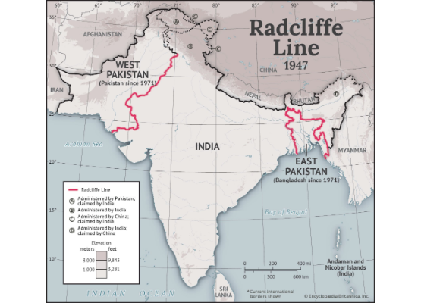
Radcliffe & Kashmir
The boundary commission, led by Sir Cyril Radcliffe, produced a notoriously biased award against Pakistan.
The Muslim-majority district of Gurdaspur was unjustly handed over, providing India with a critical land route to Kashmir.
Against the rules of partition and the demographic reality, the Hindu ruler of Muslim-majority Kashmir acceded to India.
This sparked the first war in 1948, creating a deeply entrenched dispute that remains unresolved today.
India also seized critical headworks, temporarily cutting off Pakistan's agricultural water supply.

Slide 11

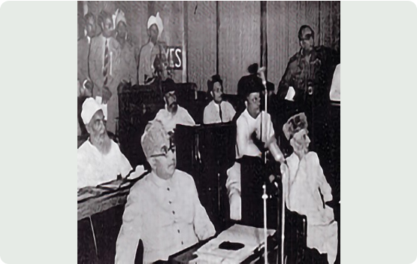
Constitutional Crisis
For the first 9 years, Pakistan operated without a constitution, relying heavily on British-era laws. The drafting process was deeply complicated by fierce ideological debates.
•
Key Debates: Bitter arguments emerged over whether Pakistan should be an Islamic state or a secular one, and whether it should have a federal or centralized system.
•
Political Chaos: This ideological deadlock led to severe instability, resulting in 7 different Prime Ministers within the first 11 years.
•
Military Intervention: In 1954, Governor-General Ghulam Mohammad dismissed the Constituent Assembly. By 1958, the chaos culminated in General Ayub Khan imposing martial law.

Slide 12

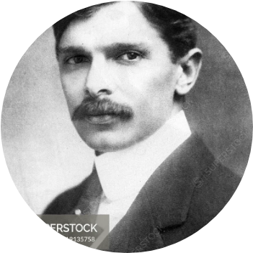

A Nation Mourns (1948)
On September 11, 1948, barely a year after independence, the father of the nation, Quaid-e-Azam Muhammad Ali Jinnah, passed away. His death was a devastating blow to the fragile, newly born state.
His unwavering resolve had been the glue holding the nation together amidst immense crises. His passing created a sudden, profound leadership vacuum.
"The foundation of your State has been laid, and it is now for you to build, and build as quickly and as well as you can."
— Quaid's Last Message to the Nation

Slide 13
Decisive Leadership
With faith, discipline and selfless devotion to duty, there is nothing worthwhile that you cannot achieve.
"
"
— Quaid-e-Azam Muhammad Ali Jinnah
Despite failing health, Jinnah served as the glue holding the nation together. He secured the State Bank, established the capital's infrastructure, and united a fractured, vulnerable populace during its darkest hours.

Slide 14

Enduring Resilience
Despite the overwhelming economic, administrative, geographic, and political hurdles of the initial years, the nation survived.
The strength to overcome these immense existential threats lay in the profound sacrifices of the people and the timeless vision of their leadership.

